Slide 1
Fluorescence Data Analysis
1-5-10uM and 1uM chips
8A current, 2 seconds exposure
Lucky Jordan

Slide 2
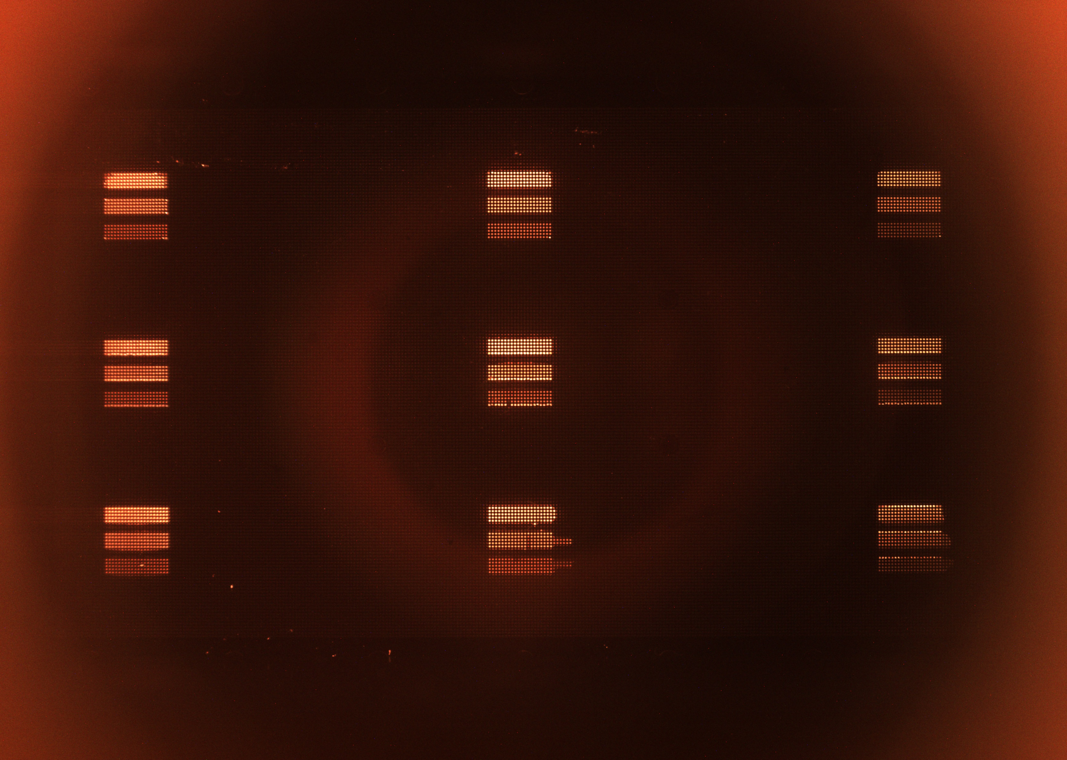
1-5-10uM chip
Left
Center
Right
Top
Middle
Bottom

Slide 3
16mm
25mm
35mm

Slide 12
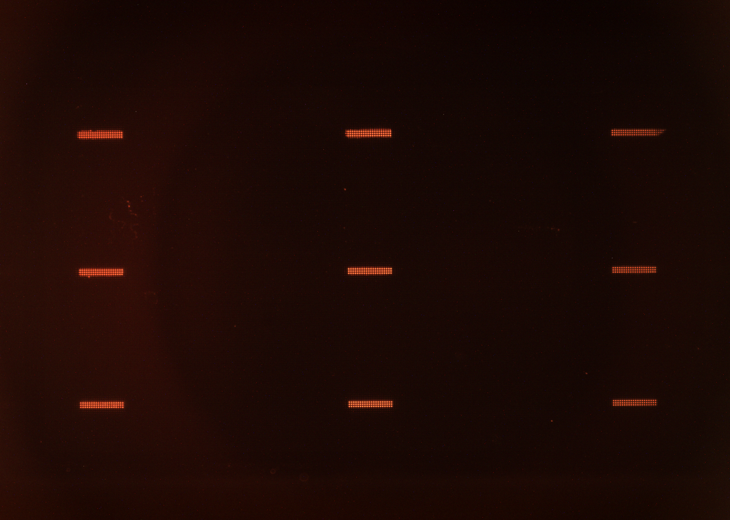
1uM chip
Left
Center
Right
Top
Middle
Bottom

